Slide 1
Data Structures.

Slide 2
HELLO!
I am Steve
I will be taking you through few data structures.
You can find me at 0705698768

Slide 3
Data Structures.
These are specialized ways of organizing and storing data in computers. It defines how data is stored and can be accessed. Common ones include List , Dictionaries and graphs.

Slide 4
What we will cover.
STACK.
It’s a linear data structure that stores items using LIFO. Items added moves to the top and top element is always removed as first.
Queue.
Same as Stack but data is stored in FIFO strategy. Items when added goes to the back of the queue.
S
Q
Binary Tree
Graphs
G
T
A non-linear data structure that contains vertices and edges. Vertices are entities in the graph that has value while edges shows association of edges.
Non linear DS used mostly for easing searching of data. It consists of a node with two child(left and right).
Notes:
Stack - Whenever a new element is added to a stack, it is added to the top of the stack, and the top element is always removed first from a stack. In this article, we’ll be looking at ways to implement and use the stack in Python

Slide 5
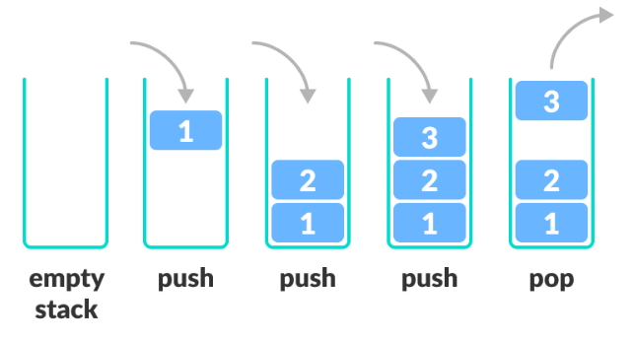
STACK DATA STRUCTURE.
Push is used to add items into the stack while pop is used to get the top item from stack
Used in building compilers and parsers.

Slide 6
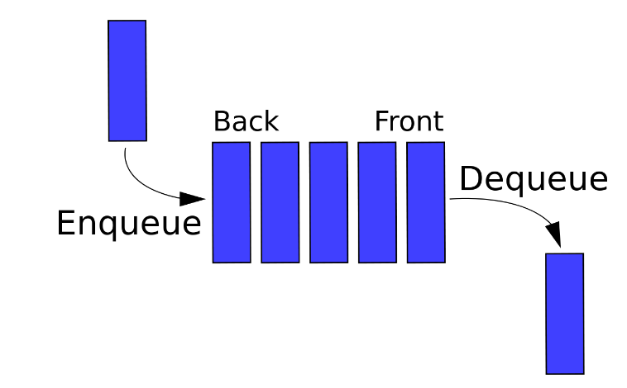
QUEUE DATA STRUCTURE.
Enqueue involves adding items to the queue at the back while Dequeue removes an item infront of the Data structure. Rear method returns back item while Front returns earliest item.
Used in CPU scheduling and Queueing problems.

Slide 7
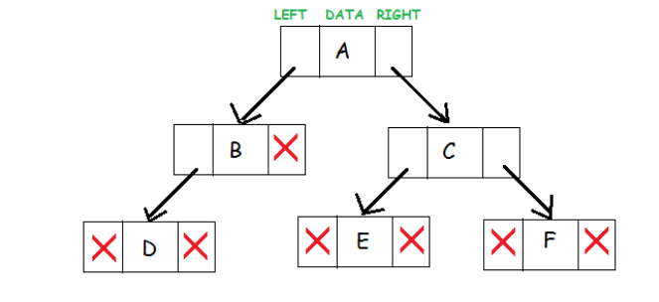
BINARY TREE DATA STRUCTURE.
Each node consists of data , pointer to left and pointer to right. Root is the topmost node while leaves are nodes without children.
Used in developing parse and syntax trees in compiler construction ,database indexing etc.

Slide 8
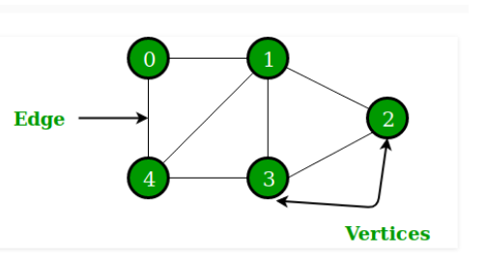
GRAPH DATA STRUCTURE.
Each Node/vertices must have to be connected to atleast one edge. Directed graphs normally have direction while for undirected graphs any moves is okay.
Used in Social Networks to map friend , places , tweets etc , page ranking by google.

Slide 9
Development these ADT
Understand the logic behind the ADT
Select your Prefered tool
Develop , Google , Google … Don’t Fear

Slide 10

Let checks on the notebook for some implementation of these Data structures.

Slide 11
REPOSITORY LINK.
This implementation uses the following:
PYTHON as Development TOOL
Check The repo Here
https://github.com/Stephen-Kamau/DataStructures_101
YOu can Clone the repo or reuse the code.

Slide 12
THANKS!
Any questions?
You can find me at
stiveckamash@gmail.com
0705698768

